Slide 1
Azure Storage
Microsoft Research

Slide 2
Azure Storage
Blobs
Storage for any type of data, analogous to files in a file system, with individual blobs storing up to 4.75 TB of data
Queues
Reliable messaging for workflow processing and for communication between applications or application components
Tables
NoSQL storage of semi-structured data for rapid development and fast access to large quantities of data
Files
File sharing using Server Message Block (SMB) protocol
Notes:
Microsoft Azure Storage is a set of services that allows you to store large volumes of data in a cost-effective manner and in a way that makes the data readily and reliably available to services and applications that consume it. Data committed to Azure Storage can be stored in blobs, tables, queues, or files. Azure blobs are ideal for storing images, videos, and other types of data, and are frequently used to provide input to and capture output from other Azure services such as Azure Stream Analytics. Azure tables provide NoSQL storage for semi-structured data. Azure queuessupport queued message transfers between applications (or parts of applications) and can be used to make applications more scalable and robust by loosely coupling them together. Finally, Azure Files use the Server Message Block (SMB) protocol to share files through the cloud and access storage as network drives.
Data stored in Microsoft Azure Storage can be accessed over HTTP or HTTPS using straightforward REST APIs, or it can be accessed using rich client libraries available for many popular languages and platforms, including .NET, Java, Android, Node.js, PHP, Ruby, and Python. The Azure Portal includes features for working with Azure Storage, but richer functionality is available from third-party tools, many of which are free and some of which work cross-platform.

Slide 3
Blob Storage
Accounts
Containers
Blobs
images
schema.jpg
a4rlabs
Png/flow.png
documents
Labs.pdf
3 to 24 characters
0-9 and a-z
Unique within Azure
3 to 63 characters
0-9, a-z, and dashes
1 to 1,024 characters
Any characters (including slashes)
URL characters must be escaped
Max. 254 path segments
Notes:
Storage begins with a storage account, which can be created in the Azure Portal. Before you can create a blob, you must create a container to store it in. Think of containers as folders in a file system and blobs as the files themselves. Storage accounts must be uniquely named and conform to a rather severe set of restrictions since storage names are used to form DNS names.

Slide 4
Blob URLs
Accounts
Containers
Blobs
images
schema.jpg
a4rlabs
Png/flow.png
documents
Labs.pdf
https://a4rlabs.blob.core.windows.net/images/schema.jpg
Notes:
Once created, a blob can be referenced by URL. The URL is formed from the storage-account name, container name, and blob name. This doesn't mean all blobs are public; they're private by default. But they can be made public, and public blobs can be downloaded simply by typing their URLs into a browser.

Slide 5
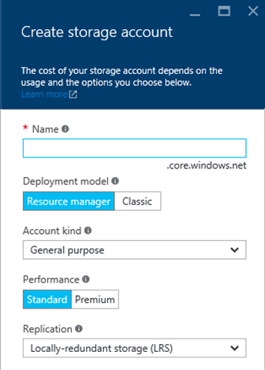
Storage Accounts
Up to 500 TB of data per account
Maximum of 200 storage accounts per subscription
Two types of accounts
"General purpose" and "Blob storage"
Four types of replication
LRS, ZRS, GRS, and RA-GRS
Support optional 256-bit AES encryption for "data at rest"
Notes:
Locally redundant storage (LRS) maintains three copies of your data. LRS is replicated three times within a single facility in a single region. LRS protects your data from normal hardware failures, but not from the failure of a single facility.
Zone-redundant storage (ZRS) maintains three copies of your data. ZRS is replicated three times across two to three facilities, either within a single region or across two regions, providing higher durability than LRS. ZRS ensures that your data is durable within a single region.
Geo-redundant storage (GRS) is enabled for your storage account by default when you create it. GRS maintains six copies of your data. With GRS, your data is replicated three times within the primary region, and is also replicated three times in a secondary region hundreds of miles away from the primary region, providing the highest level of durability. In the event of a failure at the primary region, Azure Storage will failover to the secondary region. GRS ensures that your data is durable in two separate regions.
Read access geo-redundant storage (RA-GRS) replicates your data to a secondary geographic location, and also provides read access to your data in the secondary location. Read-access geo-redundant storage allows you to access your data from either the primary or the secondary location, in the event that one location becomes unavailable.

Slide 6
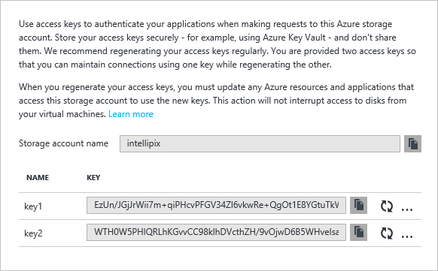
Access Keys
Access to storage by non-account-owners relies on access keys
Keys should be "rolled" periodically for security
Keys can be used to generate shared-access signatures (SAS) for secure and restricted access
Notes:
Access keys should never be handed out to other people because they provide unrestricted access to a storage account. (They're useful for connecting other services that you create to your storage accounts, in which case they stay in Azure and are never divulged to the outside world.) SAS tokens are safer because they can be time-limited and set to provide read-only access. The best way to generate a SAS token is with Microsoft's cross-platform Azure Storage Explorer. For a real-world example of what happens when you fail to protect a storage account's access keys, see http://www.pcworld.com/article/2365602/hacker-puts-full-redundancy-codehosting-firm-out-of-business.html.

Slide 7
Shared-Access Signatures
Blob URL
https://a4rlabs.blob.core.windows.net/images/schema.jpg?
st=2016-02-07T19%3A58%3A00Z&se=2016-02-08T19%3A58%3A00Z&sp=r&sv=2015-02-21&sr=b&sig=BGebg1eduvPTwQnZWZlBphM8YGP9sRYt2WiPIL70vcw%3D
Query string containing
shared-access signature
Notes:
This example shows how a SAS included in a query string can be used to provide access to an otherwise private blob. Could someone modify the query string to extend the lifetime of the SAS? They could try, but the SAS is digitally signed, so Azure will reject a modified SAS.

Slide 8
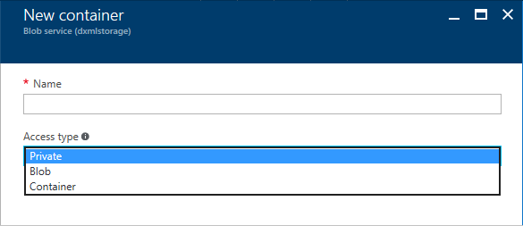
Storage Containers
Three access policies
Private – Blobs can't be read or enumerated anonymously
Container – Blobs can be read and enumerated anonymously
Blob – Blobs can be read anonymously, but cannot be enumerated
Notes:
Containers are private by default, which means only the storage-account owner (or someone who has an access key for the storage account or a valid SAS) can access its contents. However, setting the container's access policy to "Public Container" or "Public Blob" makes the container's blobs public. The difference between "Public Container" and "Public Blob" is that the latter allows the blobs in the container to be enumerated, while the latter does not.

Slide 9
Storage Blobs
Unlimited number of blobs per container
Three types of blobs
Blobs also support user-defined metadata (key-value pairs)
Block
Up to 4.75 TB
General-purpose streaming and storage
Append
Up to 195 GB
Optimized for append operations
Page
Up to 1 TB
VHDs only; optimized for random access
Notes:
Most blobs are block blobs. Page blobs are for VHDs and are used for VMs created in Azure. Most tools that let you create blobs -- for example, the Microsoft Azure Storage Explorer -- let you specify the blob type. APIs for creating blobs also let you specify the blob type.

Slide 10
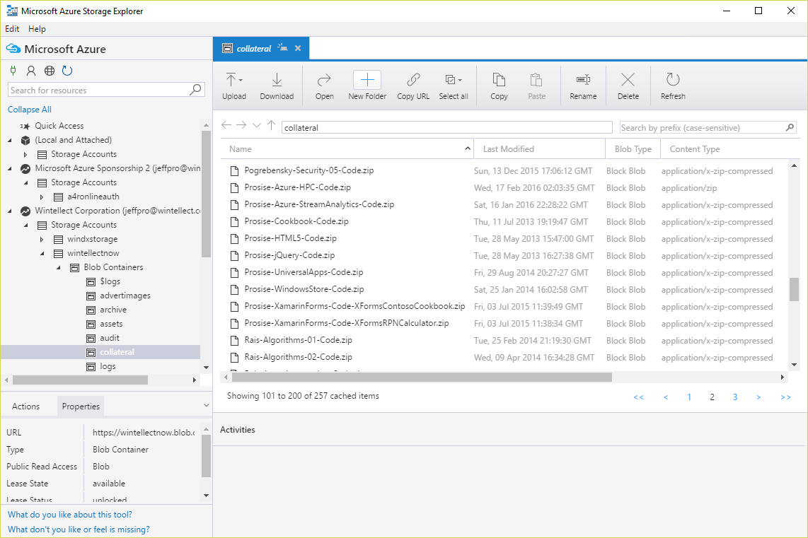
Azure Storage Explorer
Free cross-platform tool for managing Azure Storage
http://storageexplorer.com/
Notes:
The Microsoft Azure Storage Explorer provides an easy-to-use GUI interface for creating containers, uploading and downloading blobs, generating SAS tokens, and more. But if you want to use a scripting language such as Bash or PowerShell to script storage operations, the Azure CLI is the way to go.

Slide 11
Hands-On Lab
Using Azure Storage
Azure Storage HOL.html

